Slide 1


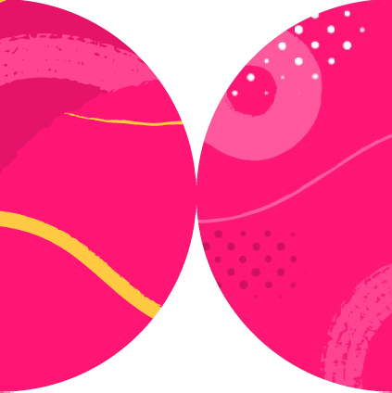

Playwright
Integration with Various Test Frameworks

Slide 2
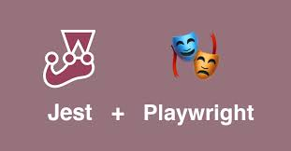

Slide 3

Introduction
Installing
Adding Playwright
Adding TypeScript
Adding Jest
Writing simple Playwright tests
Running on all browsers
Adding globalTypes.ts
Debugging our test
Summary
Overview

Slide 4
jest-playwright
Multi-browser and device (like iPhones with given screen sizes) support
jest-dev-server integration which can start your webserver like create-react-app before running the tests
expect-playwright integration which provides common expect helper functions

Slide 5
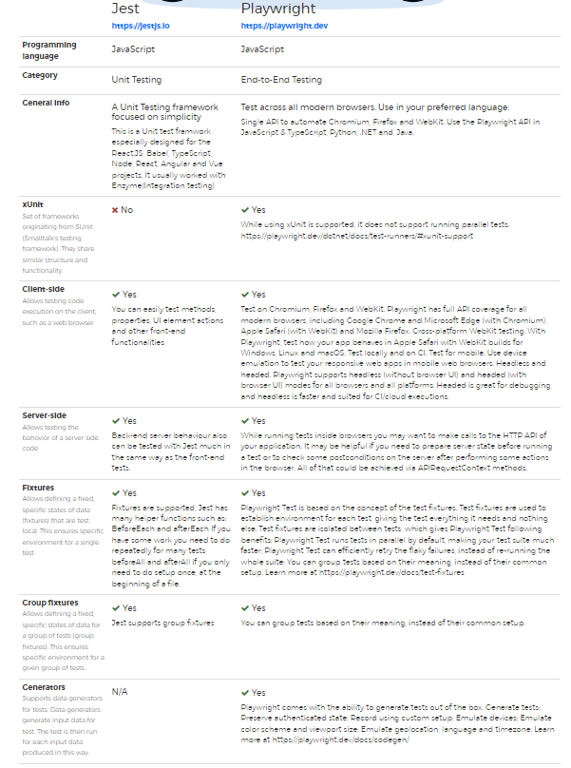
Summary

Slide 6


Slide 7
Introduction
Initializing a Node.js project
Adding Playwright
Adding Mocha
Adding TypeScript
Adding @types/node
Adding TypeScript Execute (tsx)
Creating a .mocharc.json
Updating test script in package.json
Writing a simple Playwright test
Running your test
Summary
Overview

Slide 8
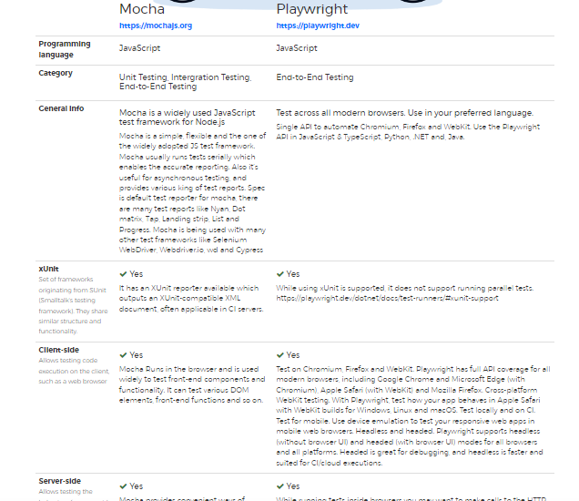
Summary

Slide 9
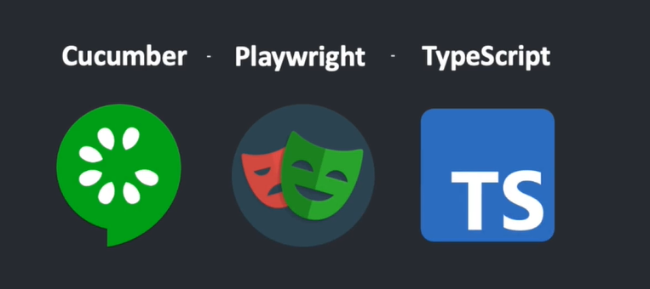

Slide 10
How to Integrate Cucumber With Playwright
Introduction
Create a folder e.g playwright_cucumber
What is Cucumber ?
Set up Cucumber With Playwright
Create feature file
Create a runner file
Script for npm test
First test run
Create Step definition
Summary
Overview

Slide 11
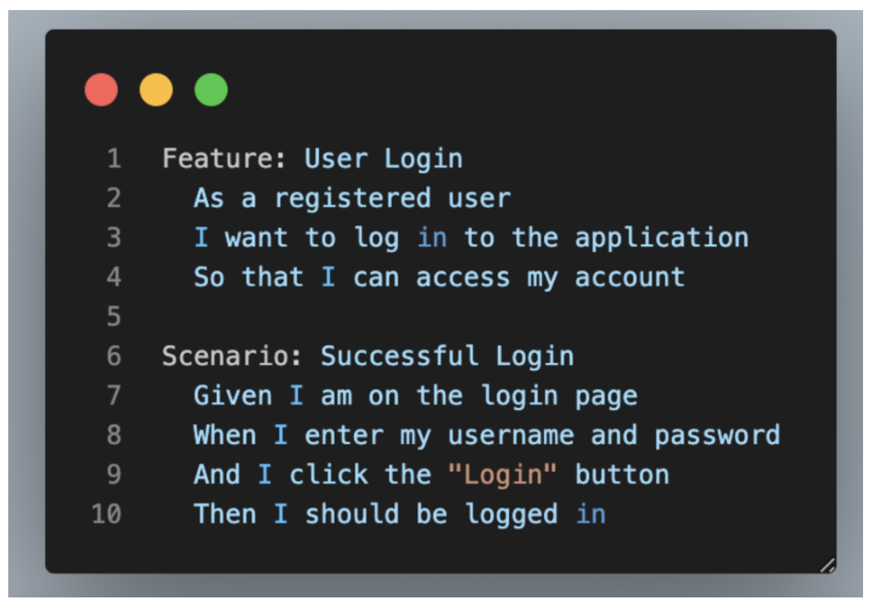

Slide 12
Playwright and Cucumber Automation using TypeScript
Install Playwright
Install Cucumber Plugin
Prepare Project Structure
Create Feature file
Create cucumber.json file
Add script to package.json
Create Step Definitions
Update setting.json file
Summary
Overview

Slide 13
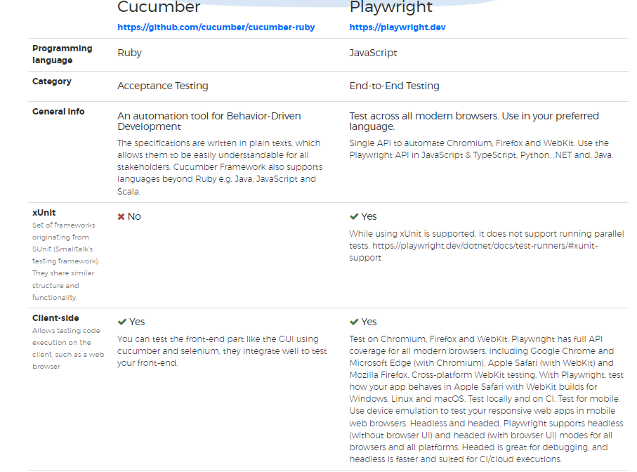
Summary

Slide 14
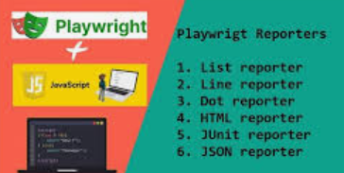

Slide 15
Mastering Playwright Reporting
What is Playwright?
Playwright Parallelism (and Disabling Parallelism)
How to Run Tests on Playwright
Configuring Playwright Reporting
Multiple Reports
Built-In Reporters
1.List Reporter
2.Line Reporter
3.Dot Reporter
4.HTML Reporter
5.JSON Reporter
6.JUnit Reporter
7.GitHub Actions Annotations
Custom Reporters
Allure for Playwright
Overview

Slide 16
Built In and Custom Reporters
In Playwright

Slide 17


Slide 18


Slide 19
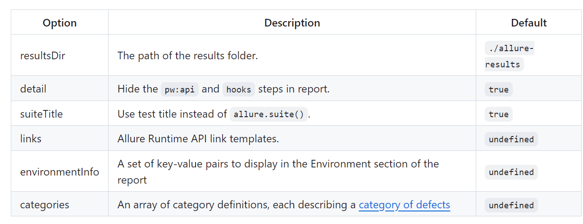
Allure Playwright options
Use the following options to configure Allure Playwright:
https://allurereport.org/docs/playwright-reference/#metadata
https://allurereport.org/docs/playwright-configuration/
.

Slide 20
Generate beautiful HTML reports using Allure Report and your Playwright tests.
Use the provided functions from 'allure-js-commons' to integrate your Playwright tests with Allure.
Note that while standard features require importing the test object from Playwright, the additional features also require importing the functions directly from 'allure-js-commons'
Summary

